Slide 1
Hangman via Zoom
Breakout Room Prototype

Slide 2
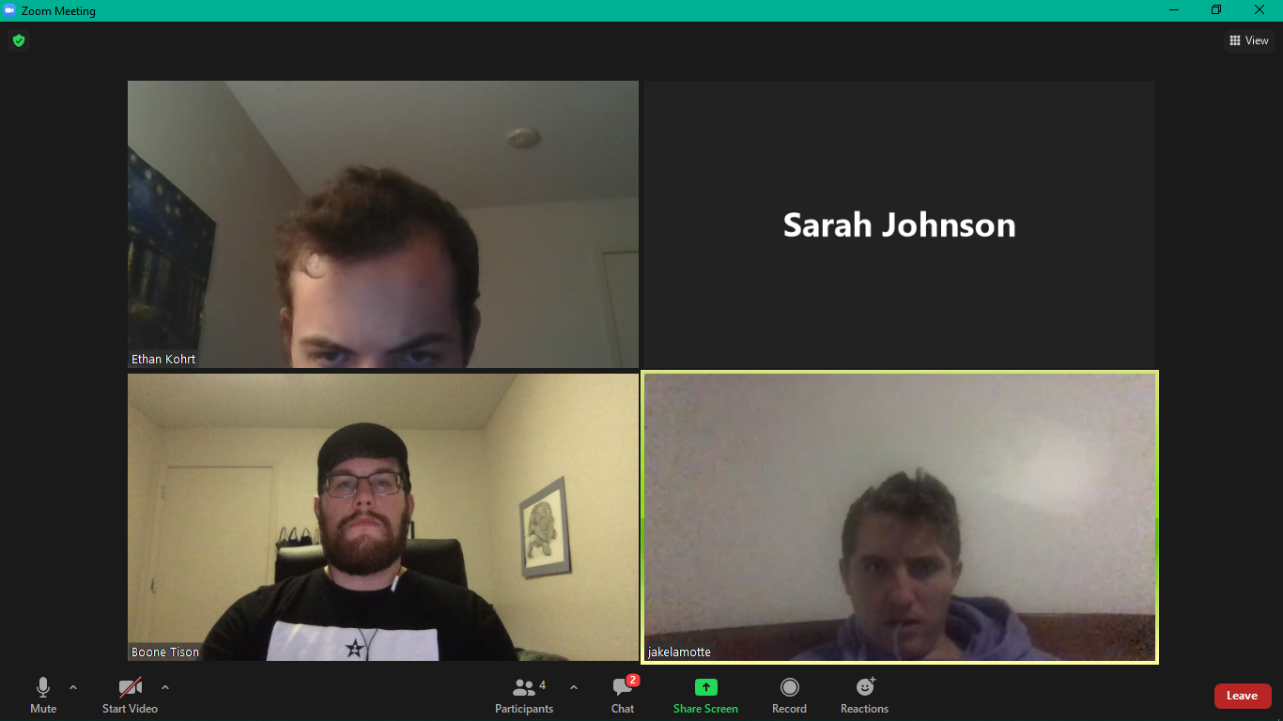

Mafia
Slither.io
Hangman
The Obstacle Course
In-Chat
Full Screen

Slide 3


Players Score
1.Sarah 0
2.Ethan 0
3.Jake 0
4.Boone 0
HANGMAN
Rules:
Pick a correct letter (per letter present in word/phrase): +10 points
Pick an incorrect letter: -5 points
Ever incorrect guess results in a body part added to the pole. When a full body is displayed the game is over and the user with the highest score wins.
If guessed correctly the user who correctly identifies word(s) or phrase wins.
Pick a letter to get started
_ _ _ _ _ _ _ _ _ _ _ _ _
Dog Breeds
Notes:
User can have the option to provide a theme/topic

Slide 4
HANGMAN
Players Score
1.Sarah 20
2.Ethan 0
3.Jake 0
4.Boone 0
Letters :
A B C D E F G H I J K L M
N O P Q R S T U V X Y Z
_ _ _ _ A _ _ _ _ _ A _
Dog Breeds
Notes:
Sarah says “A”

Slide 5
HANGMAN
Players Score
1.Sarah 20
2.Ethan 20
3.Jake 0
4.Boone 0
Letters :
A B C D E F G H I J K L M
N O P Q R S T U V X Y Z
Letters :
A B C D E F G H I J K L M
N O P Q R S T U V X Y Z
_ E _ _ A _ _ _ E _ A _ _
Dog Breeds
Notes:
Ethan says “E”

Slide 6
Players Score
1.Sarah 20
2.Ethan 20
3.Jake - 5
4.Boone 0
HANGMAN
Letters :
A B C D E F G H I J K L M
N O P Q R S T U V X Y Z
_ E _ _ A _ _ _ E _ A _ _
Dog Breeds
Notes:
Jake says “i”

Slide 7
Hangman via Zoom
Chat Based Prototype

Slide 8
Mafia
Slither.io
Hangman
The Obstacle Course
In-Chat
Full Screen

Slide 9
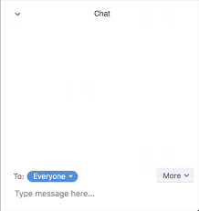
Boone Tison has challenged you to a game of Hangman.
Do you accept?
Accept Decline
Welcome to 2-player Hangman!
_______
| |
|
|
|
Pick a letter
_ _ _ _ _ _
Boone TIson
EfEEgfggsgrgjiorjgirjgjigreogjrogjogige

Slide 10
Welcome to 2-player Hangman! Sarah accepted you!
_______
| |
| 0
|
|
Sarah chose “E” There are no “E”s `
Pick a letter
_ _ _ _ _ _
Boone TIson
EfEIgfggsgrgjiorjgirjgjigreogjrogjogige

Slide 11
_______
| |
| 0
|
|
Boone chose “E”. There are no “E”’s.
Pick a letter
Sarah chose “I”. There is 1 “I”.
_ I _ _ _ _
Boone TIson
EfEfggsgrgjiorjgirjgjigreogjrogjogige

